Slide 1
Industry Oriented Hands-on Experience
on
FEMsafe
(Course Code: 22CS422)
Presented By:
1. Niharika(2211985035)
1

Slide 2





Sustainable Development Goals
SDG 5: Gender Equality
Reduces gender-based violence risks.
Creates safer mobility options (night-time vetted taxis)..
Builds confidence and independence among girls and women.
SDG 11: Sustainable Cities and Communities
Vetted taxi drivers and live tracking contribute to safer transport systems
Integration with law enforcement creates stronger, community-based safety infrastructure.
FEMsafe fosters inclusive, safe, and resilient public spaces for girls.

Slide 3
Introduction
In many regions, especially in urban and semi-urban areas, women often face safety concerns during emergencies and while traveling alone. Traditional safety measures mainly depend on manual communication, which can lead to delays in critical situations. There is often no quick and organized way to alert others or access help instantly.
Our project aims to solve this problem by developing a digital platform (FEMsafe) that provides quick emergency support through a simple web interface. It allows users to send SOS alerts, manage emergency contacts, and access safer travel options when needed. This system improves response time, enhances personal security, and promotes the use of technology for social good.
Key Features :
Emergency SOS Button
Night-Time Taxi Booking
Live Ride Tracking
User-Friendly Interface
Location-Based Services

Slide 4
Problem Statement & Need Statement
Problem Statement:
Women and girls across the world face daily safety challenges, especially in public spaces and during night-time travel. Incidents of harassment, assault, and lack of immediate help create fear and restrict their freedom of movement. Existing safety measures are often fragmented, unreliable, or slow to respond, leaving many without timely protection in critical situations. There is a strong need for an integrated and easily accessible system that can provide instant assistance and improve personal safety. Such a system can empower users to take quick action and increase their confidence in handling emergency situations.
Need Statement:
There is an urgent need for a dedicated, technology-driven safety platform that empowers women with instant emergency support, secure travel options, and access to verified safety resources. FEMsafe bridges this gap by combining real-time alerts, safe mobility services, and community-driven support, ensuring that women can live, work, and travel with confidence. It also helps reduce response time during emergencies and improves overall personal safety. Additionally, it promotes awareness and encourages proactive safety measures among users.

Slide 5
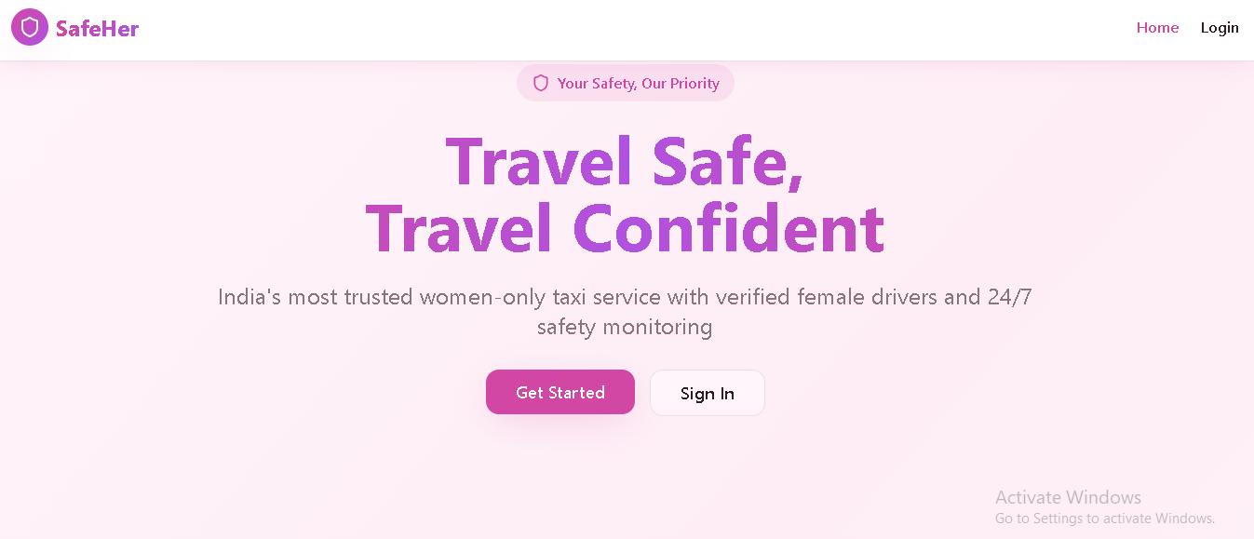
Web Design

Slide 6
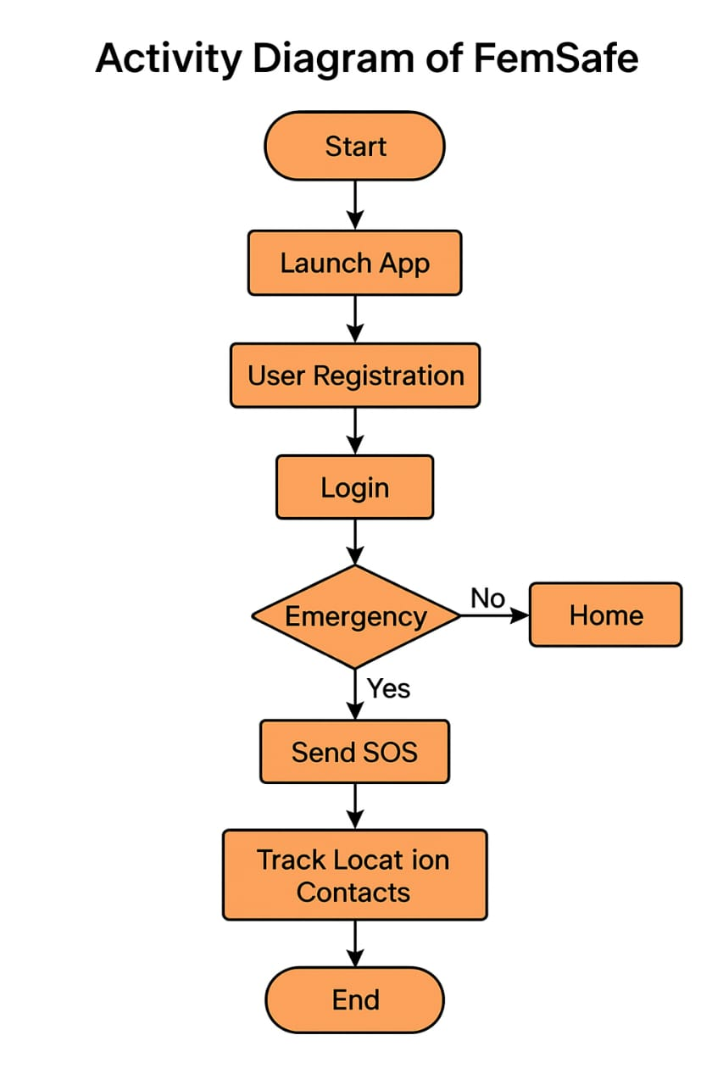
Activity Diagram

Slide 7
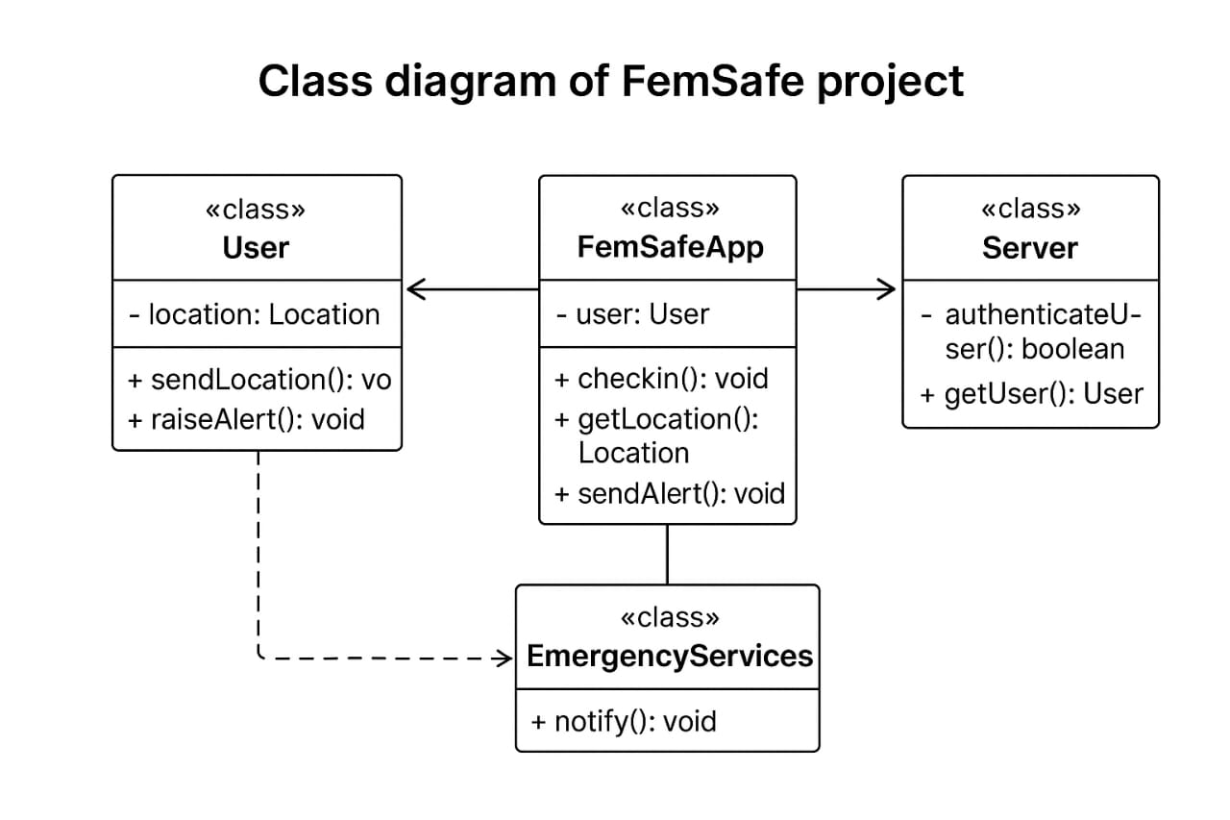
Class Diagram

Slide 8
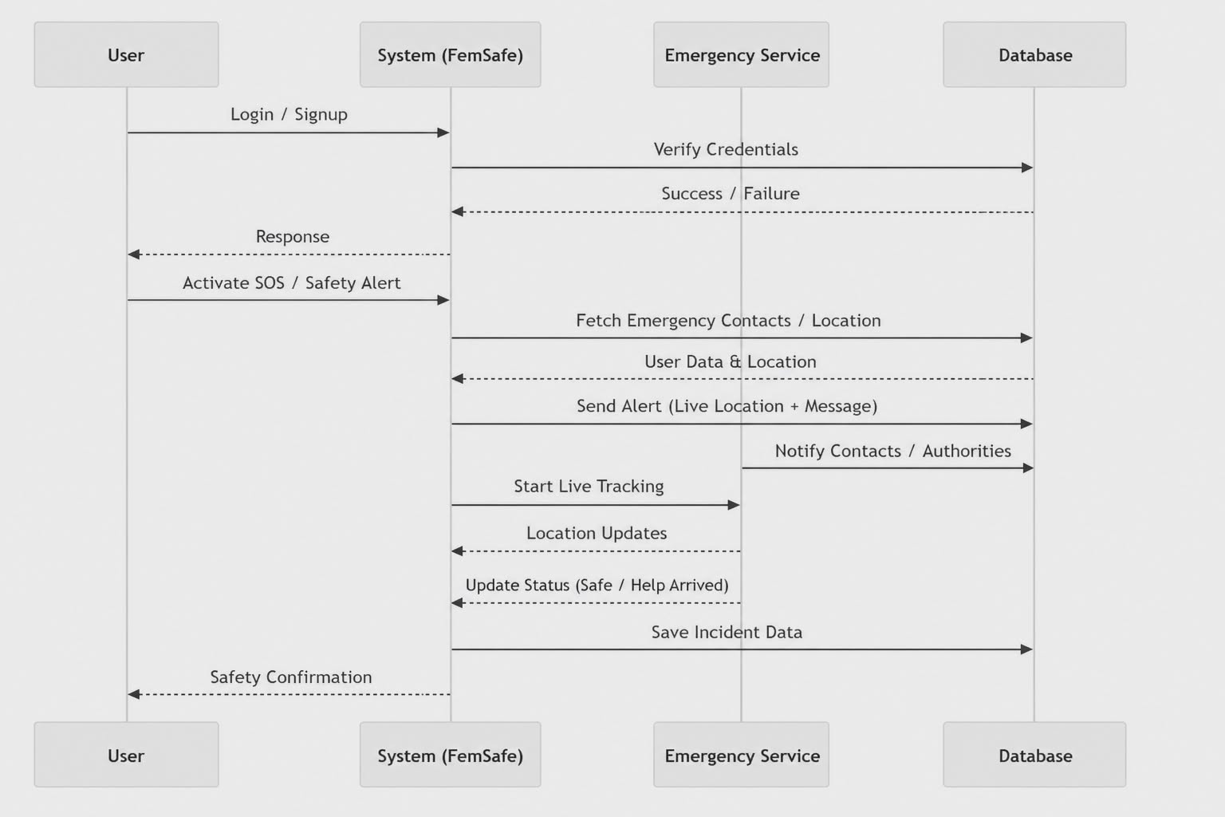
Sequence Diagram

Slide 9
Technology Stack
Frontend Technologies React.js
A JavaScript library used for building the user interface.
Provides a component-based architecture for reusable UI elements.
Ensures fast rendering using the virtual DOM.
Manages state efficiently with React Hooks (useState, useEffect).
Tailwind CSS
A utility-first CSS framework for rapid UI development.
Offers a highly customizable and responsive design without writing extensive CSS.
Ensures a modern and visually appealing user interface.
Backend Technologies Node.js
A runtime environment that enables server-side execution of JavaScript.
Handles multiple simultaneous requests efficiently using an asynchronous, non-blocking architecture.
Facilitates seamless integration between the frontend and backend using a single language (JavaScript).

Slide 10
Technology Stack
Express.js
A lightweight web framework for Node.js used to build RESTful APIs.
Simplifies backend development by providing robust routing and middleware support.
Ensures secure data handling and authentication processes.
Database Management MongoDB
A NoSQL database that stores data in a flexible JSON-like format.
Provides high scalability and performance for handling large volumes of healthcare data.
Uses collections to manage users, doctors, appointments, and payments efficiently.

Slide 11
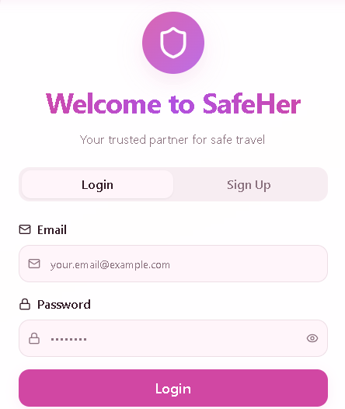
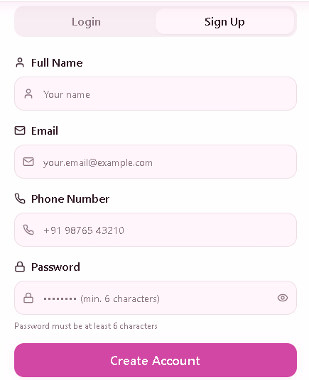
Login/Signup Page

Slide 12
Conclusion
The development of FEMsafe aims to enhance women’s safety by providing an efficient and user-friendly digital platform for emergency support. By leveraging modern web technologies like React.js, Tailwind CSS, Node.js, Express.js, and MongoDB, the system ensures a fast, secure, and scalable experience. It enables users to quickly send SOS alerts, manage emergency contacts, and access safety features in one place.
In conclusion, FEMsafe successfully combines modern technologies to deliver a practical and accessible solution for personal safety. With a focus on reliability, quick response, and ease of use, this project opens the scope for future enhancements such as real-time tracking, integration with emergency services, and mobile applications, making it a valuable contribution toward technology-driven safety solutions.

Slide 13
Future Scope
● Real-time location tracking – Track user location during emergencies for faster assistance
● Live alert notifications – Send instant alerts to emergency contacts via SMS/Email
● Online service integration – Connect with police helplines and emergency services
● Mobile application – Develop Android and iOS apps for better accessibility
● Notifications and alerts – Provide real-time updates and emergency confirmations
● Emergency auto-calling feature – Automatically call saved contacts during critical situations
● AI-based safety recommendations – Suggest safe routes and precautions based on user behavior
● Multi-region expansion – Expand the platform to serve users across different cities and regions

Slide 14
Thank You

